Slide 1

CtrlUP Stick
Xavier Law
Christopher Grigor
Ontario Tech University
April 2022
Industrial Design for Game hardware

Slide 2



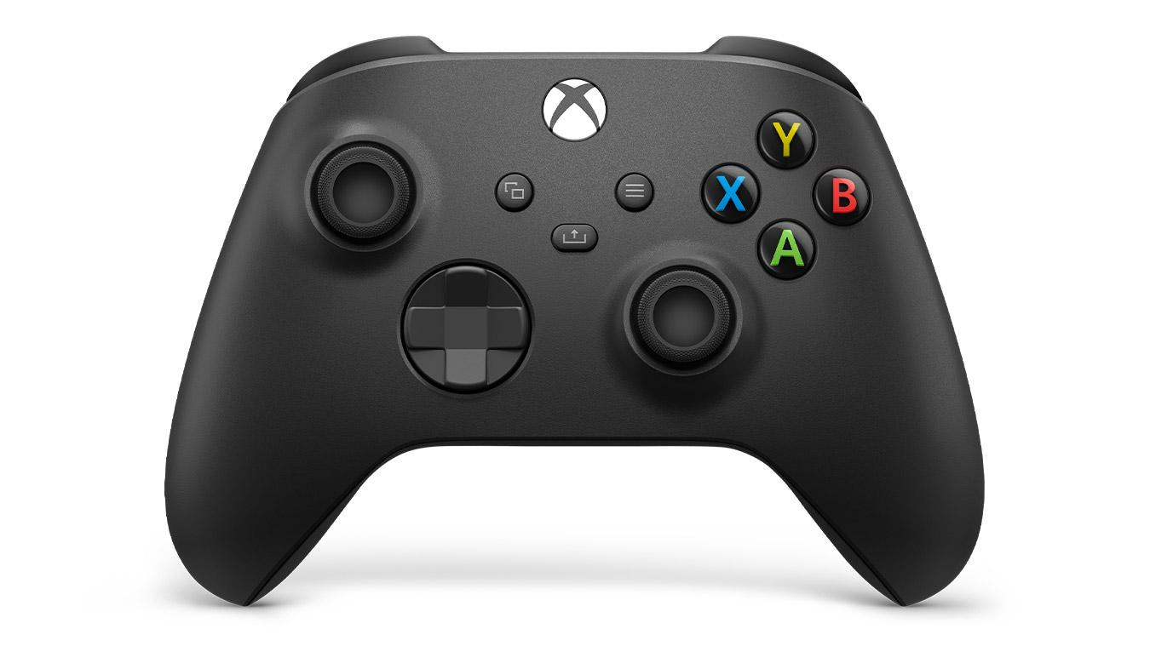

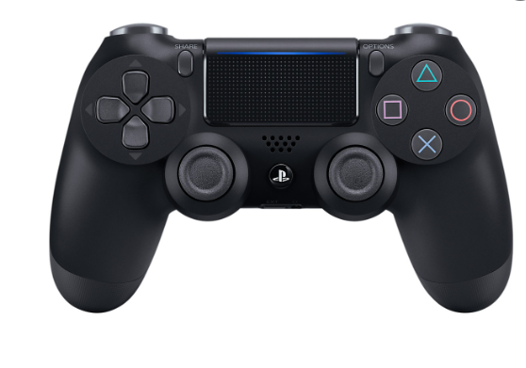

Slide 3
1
5
2
6
Table of Contents
3
7
8
4
Introduction
Methodology
Justification
Development - system architecture - wiring - tinkerCAD
Project Goal
Demo
Literature Review
Results & Conclusion

Slide 4
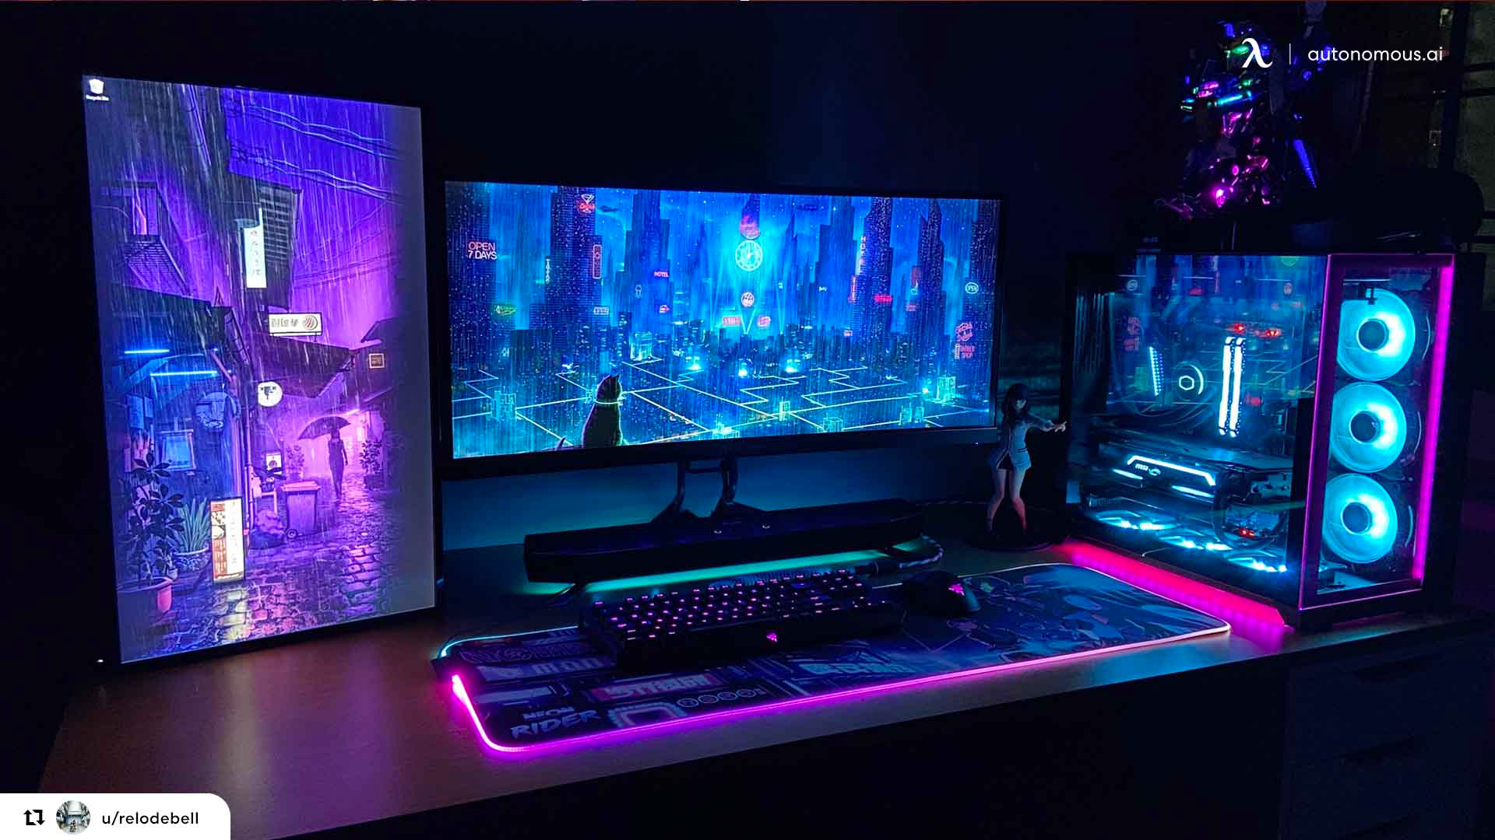
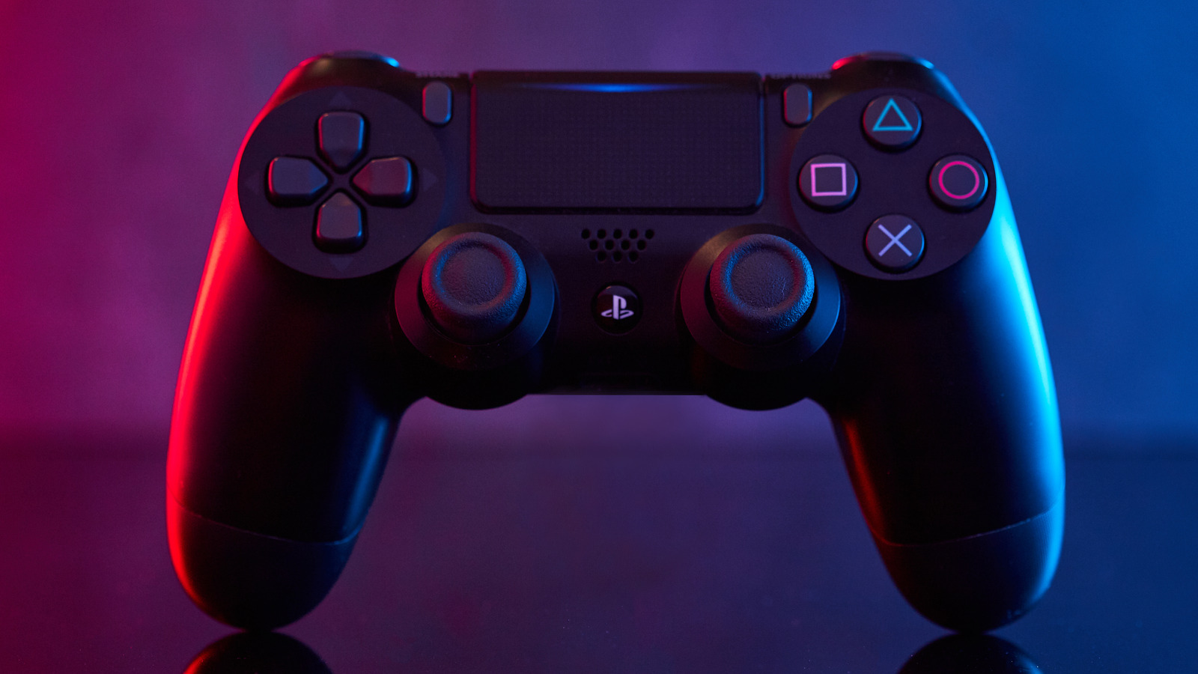
Introduction
Not uncommon for individuals to suffer from missing upper body limbs that prohibit them from using everyday controllers on the market.
Around 1.7 million people are living with missing upper body limbs.
In addition, there are also those who are born with missing arms or fingers.
Those who suffer from these issues or others such as a weaker hand from carpal tunnel may find it hard to use a normal gaming setup.
Notes:
It is not uncommon for individuals to suffer from missing upper body limbs that prohibit them from using everyday controllers on the market. In the U.S, limb amputations from trauma occur quite frequent, with 3.8 individuals per 100,000 and 2.8 of those commonly being fingers. This totals at around 1.7 million people living with missing upper body limbs [2]. In addition, there are also those who are born with missing arms or fingers [3]. Those who suffer from these issues or others such as a weaker hand from carpal tunnel may find it hard to use a normal gaming setup.

Slide 5

Justification
Video games are the most popular sources of entertainment, larger than sports and TV
This project explores the idea of creating a one-hand controller with the main implications of using it for games.
A large amount of people will benefit from being able to use a controller with only one hand.
The goal of this project is to provide a possible solution in accessibility, for those people missing or weakened arms.
Without accessible controller designs - such as a one handed controller - millions of people are left unable to play video games.
Notes:
A large amount of people will benefit from being able to use a controller with only one hand. This project explores the idea of creating a one-hand controller with the main implications of using it for games. The goal of this project is to provide a possible solution in accessibility, for those people missing limbs. Without accessible controller designs - such as a one handed controller - millions of people are left unable to play video games.

Slide 6
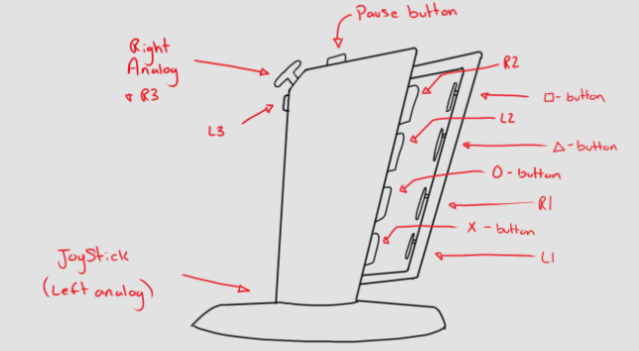
Project Goal
The project explores the idea of creating a one-hand controller with the main implications for games.
Provide possible solution in accessibility, for those who may be missing limbs or lack mobility

Slide 7
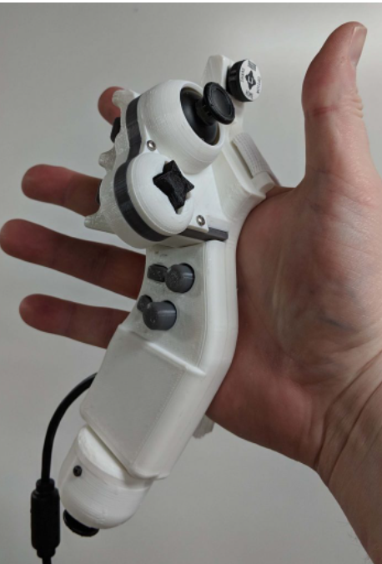
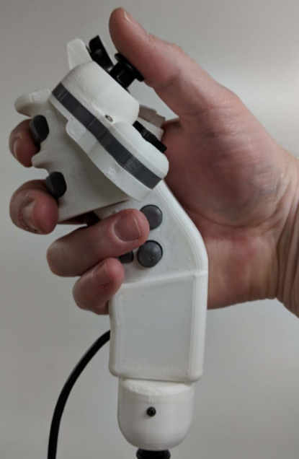
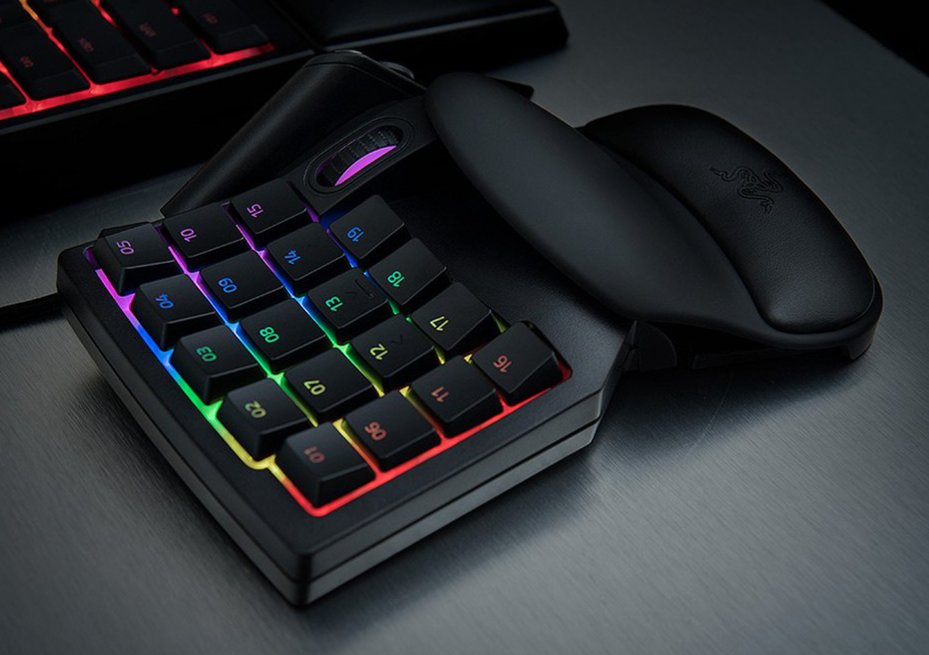
Literature Review
Benheck PS4 Single Hand Controller
Accessibility in Video Games
4 types of categories in accessibility
Motor: Ability to provide correct inputs when playing a game
Motor impairment is what we are attempting to provide a solution to
Design of a Game Controller for People with Motor Impairment
Element that allows for user to place controller onto a fixed surface for stable support
Ergonomic research shows thumb, index and middle finger have the most control
Paper also goes into using lighter switch options, that way less force is required to activate
Razer Tartarus V2
32 keys
8-way directional thumbpad
Ergonomic, curved
Notes:
Here we will go over briefly some of the papers we looked at as well as some related controllers on the market

Slide 8
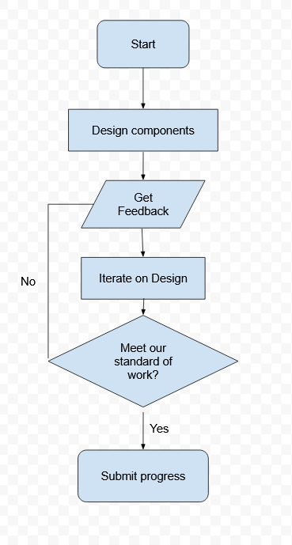
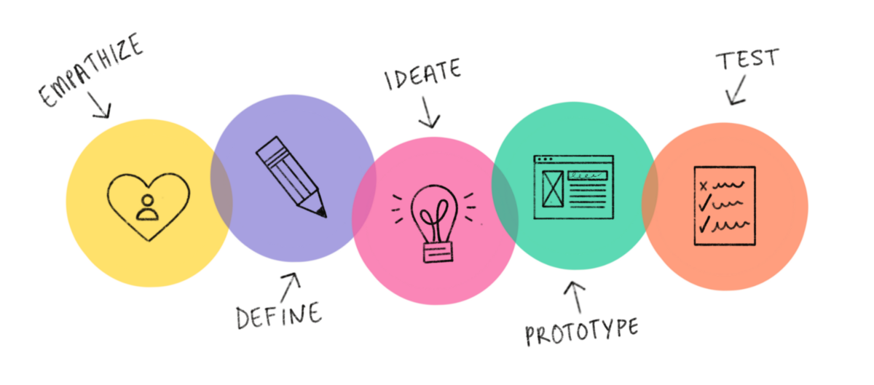
Methodology
Start with our idea
Design components based on our goal - a one handed universal controller
Gather feedback
Iterate based on feedback
Ensure everything is working
Submit progress

Slide 9
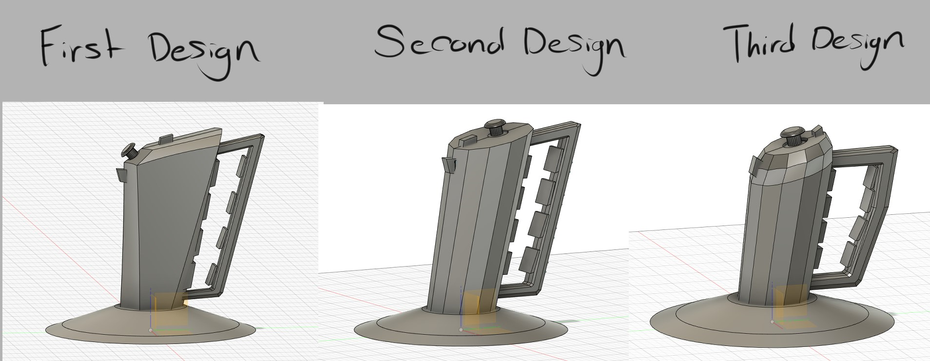
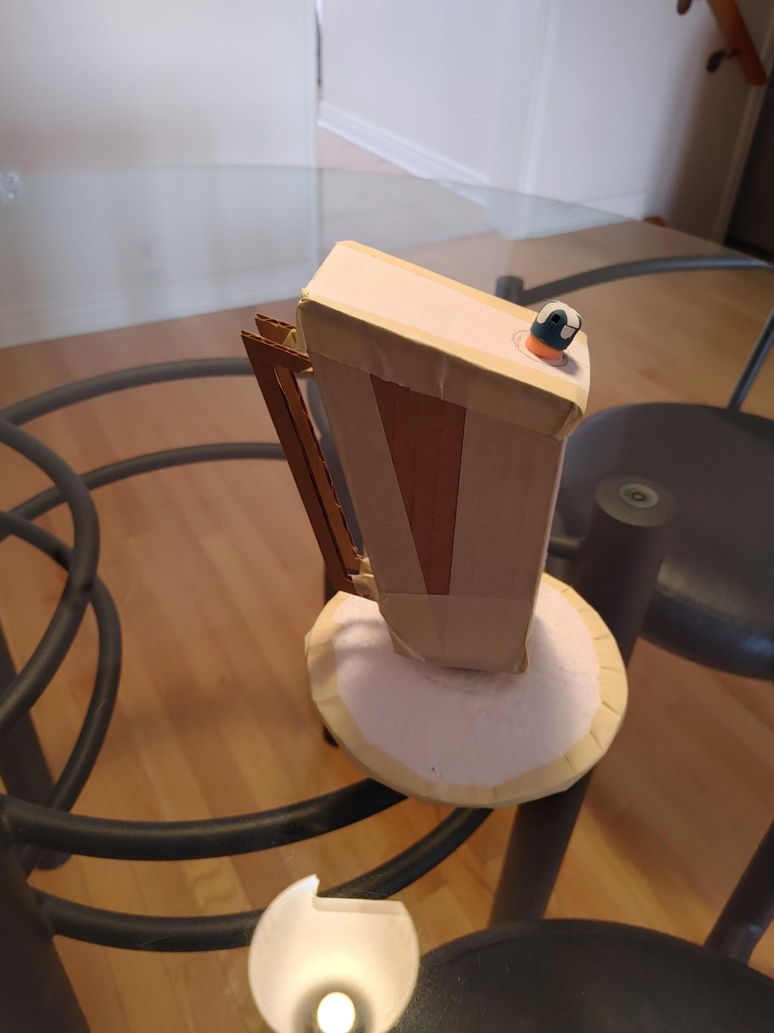
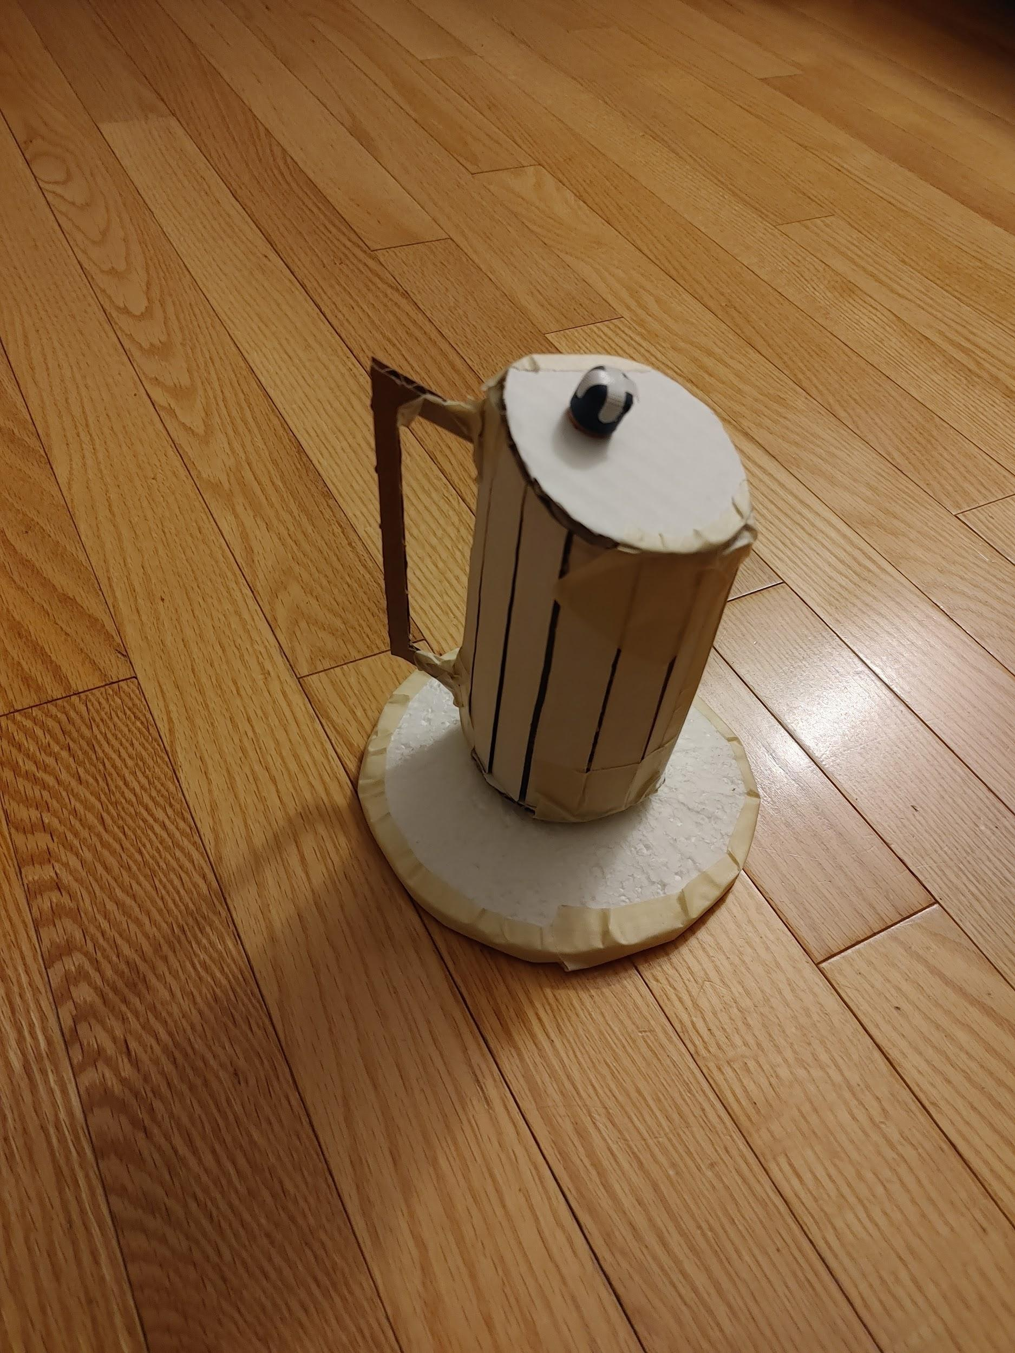
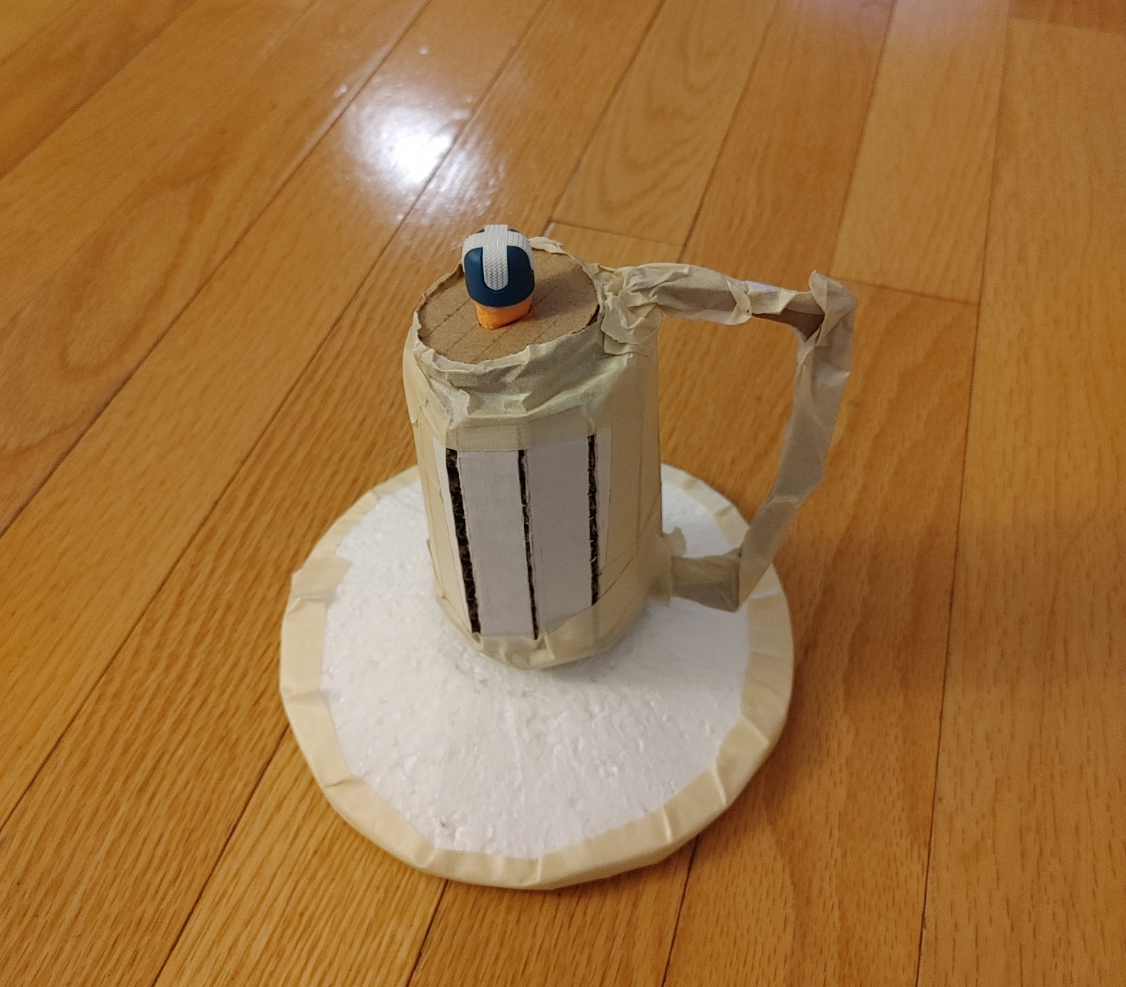
Development
Notes:
This is analysis and characterization
Study design

Slide 10
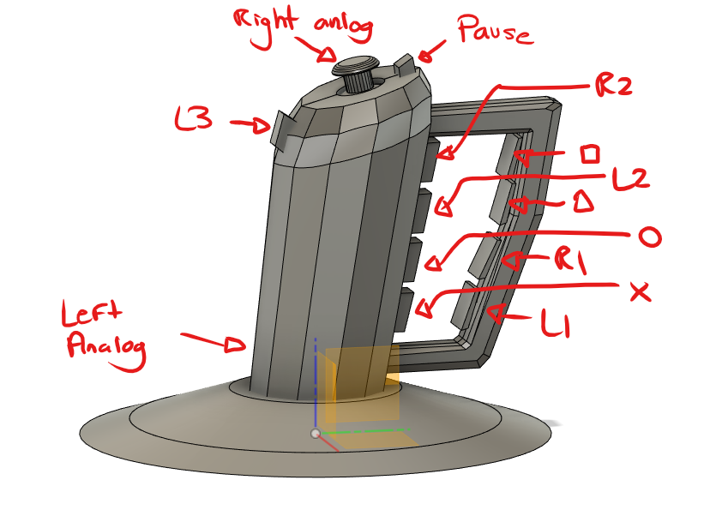
System Architecture
Notes:
This is proposed system architecture

Slide 11



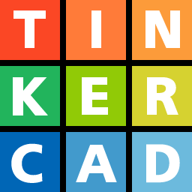


Development tools

Slide 12
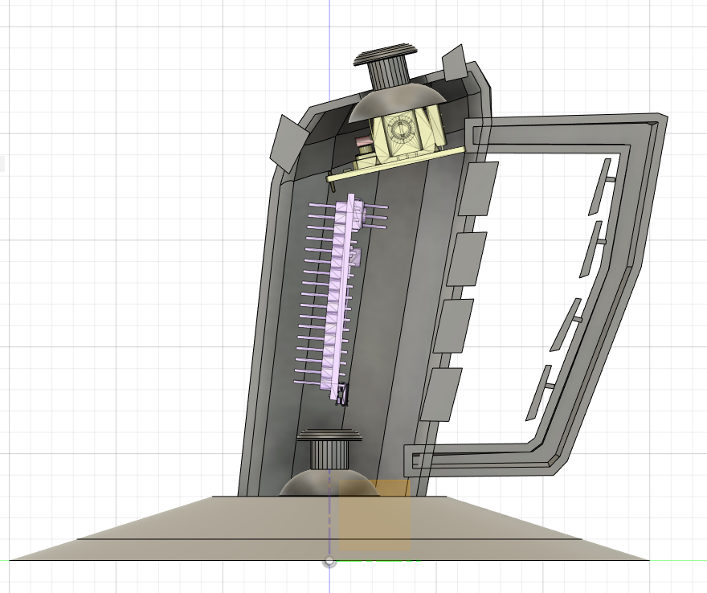
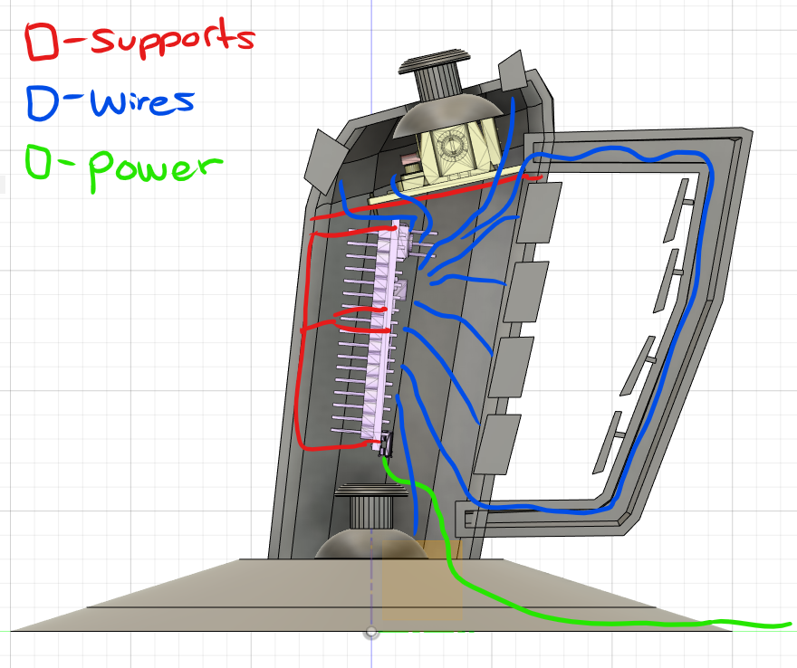
Wiring
Notes:
This is the subsystem development

Slide 13
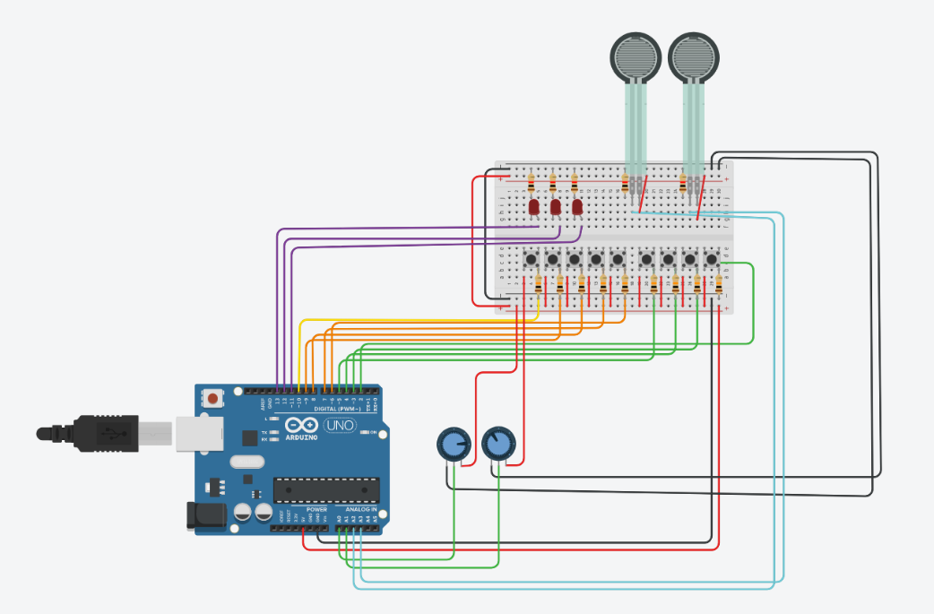
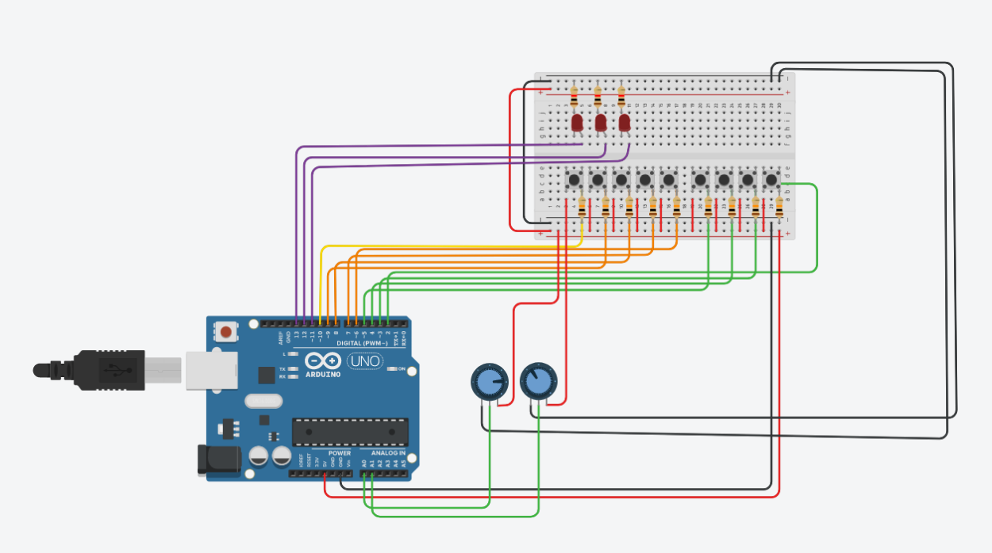
Wiring - Tinkercad
Notes:
This is the study design

Slide 14
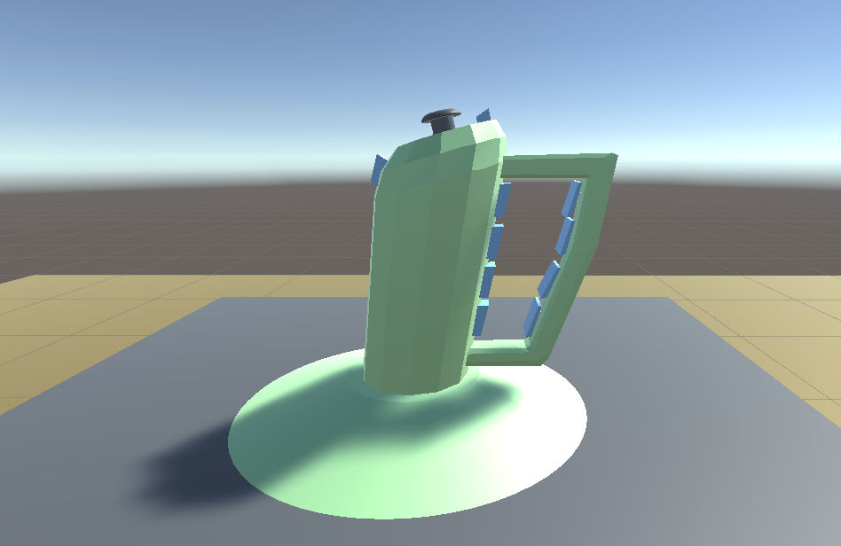
Demo

Slide 15
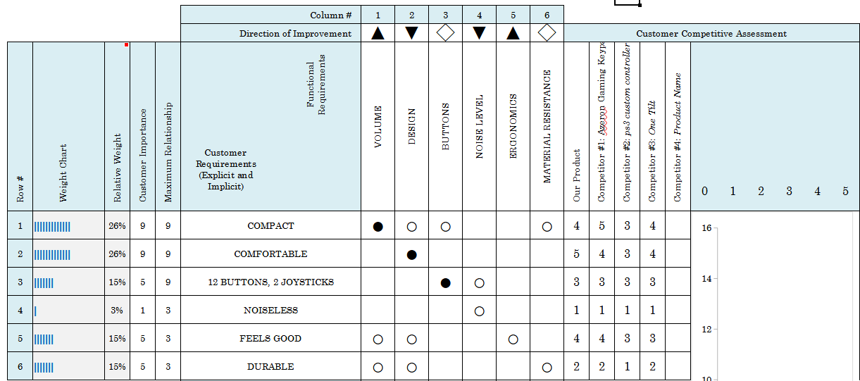
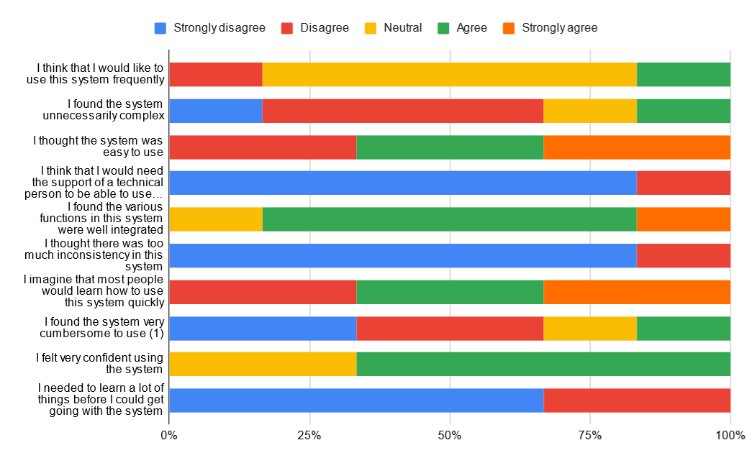
Results
QFD: House of Quality
System Usability Survey
SUS Score: 81.25
Based on Second Design
Done on April 7, 2022

Slide 16
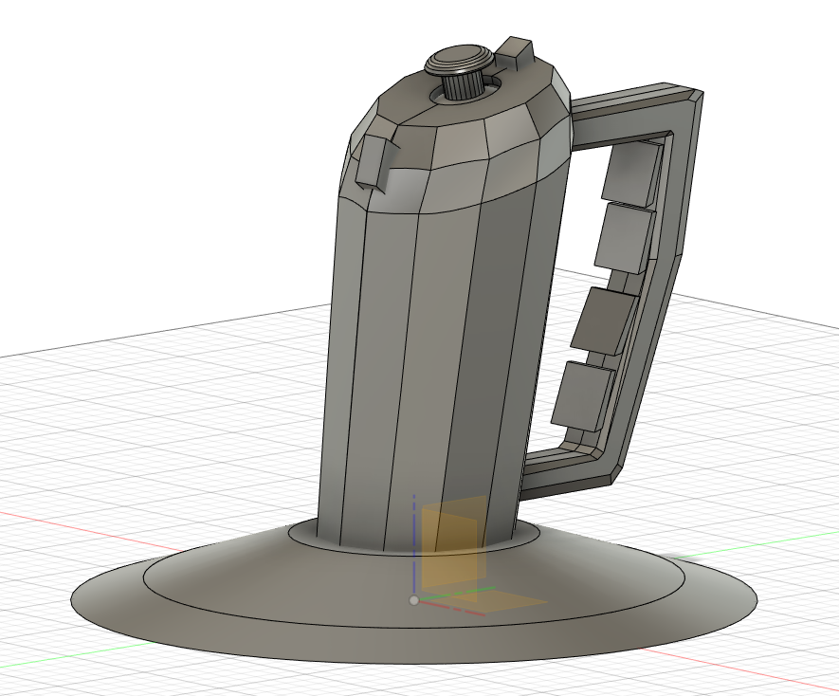
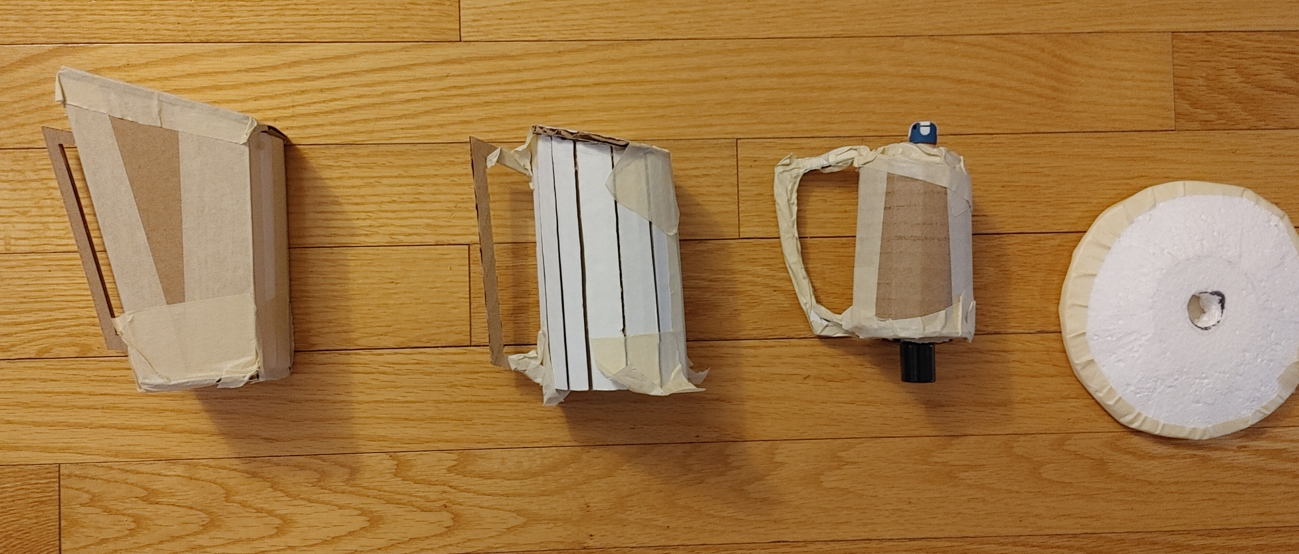
Conclusion
Numerous changes made throughout the term
Controller continues to become smaller until the final version was achieved
We were able to successfully design a universal one handed controller

Slide 17
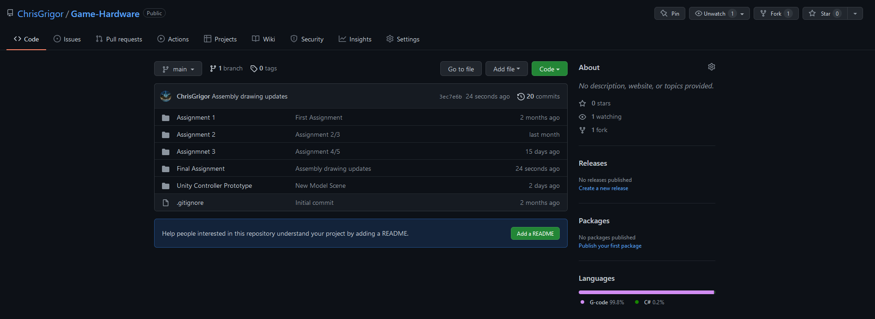
Thanks

